Slide 1

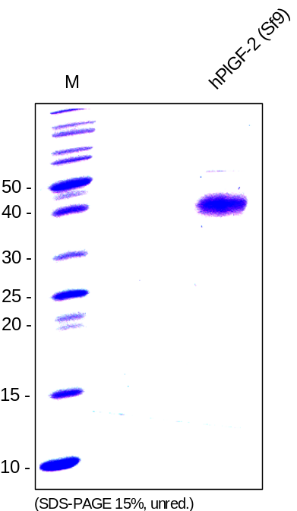
Reliatech GmbH
Recombinant human PlGF-2
(Cat #300-019S / 300-019 / 300-020)
Fig. 1: SDS-PAGE analysis of recombinant human PlGF-2 produced in insect cells. Samples was loaded in 15% SDS-polyacrylamide gel under non-reducing conditions and stained with Coomassie blue.
http://www.reliatech.de / orders@reliatech.de

